Slide 1
Course: Data Structure
(Course Code : ETCCDS202)
UNIT-1: Foundations of Data Structures
Dr. Shahjad, Mr. Deepak, Neetu Ma’am​

Slide 2
Session 3:
Time & Space Complexity (Big-O, Θ, Ω)

Slide 3
Recap
Quick Recap
What is data?
Give one example.
What is the difference between data and information?
Why do we need data structures in programs?
What problems occur if data is stored randomly?

Slide 4
Session 3: Learning Objectives
By the end of this session, will be able to:
Define and understand algorithms
Identify key algorithm properties
Describe steps in algorithm development
Analyze time and space complexity
Understand best, worst, and average cases

Slide 5
Asymptotic Analysis

Slide 6
How do we decide which algorithm is better?
Given two algorithms for the same problem, how do we decide which one is better
One approach- implement both the algorithms on same machine.
There are many problems with this approach.
Dependency on programming & machine dependent factors.
Second approach-Asymptotic Analysis

Slide 7
Asymptotic Analysis of Algorithms
We estimate the performance of an algorithm in terms of input size (we don’t measure the actual running time);
Determines the growth rate of algorithms;
Asymptotic analysis determines the best case, average case, and worst case scenario;
To compare the efficiency of different algorithms;
Asymptotic Analysis is not perfect,
but that’s the best way available for analyzing algorithms

Slide 8
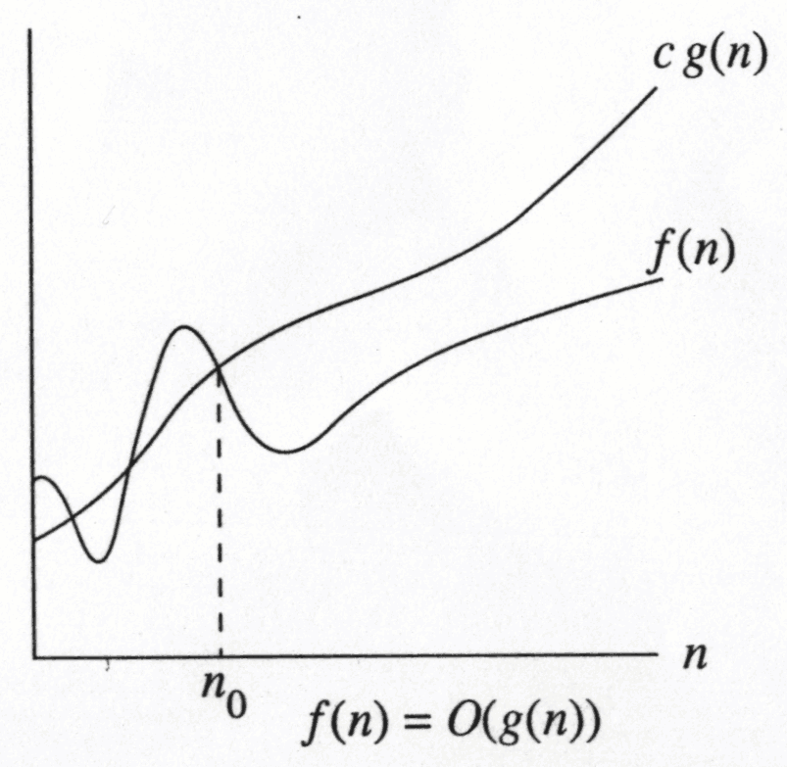
Big-O Notation
Big-O is an Asymptotic Notation for the worst case
It provides us with an asymptotic upper bound for the growth rate of runtime of an algorithm
Say f(n) is your algorithm runtime, and g(n) is an arbitrary time complexity you are trying to relate to your algorithm.
f(n) is O(g(n)), if for some real constants c (c > 0) and n₀,
Such that f(n) <= c g(n) for every input size n (n > n₀).
f(n) grows no faster than g(n) for “large” n
g(n) defines an upper bound on f(n)

Slide 9
Big-O Notation
Examples:
If f(n)=2n+3 is your algorithm runtime ,
Can we write f(n)=O(n)?
f(n) = 3*n^2 and g(n) = n;
Is f(n)=O(n)?
2n + 3 is O(n) and 5n is O(n);
place 2n + 3 and 5n in the same category
Big-Oh allows us to ignore constant factors and lower order (or less dominant) terms

Slide 10
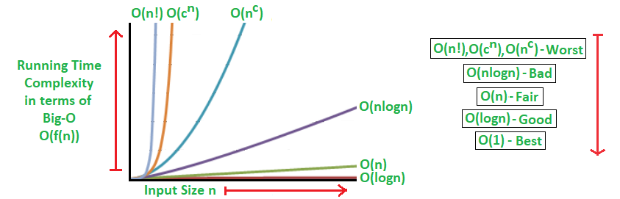
Common Asymptotic notations & comparison
constant | Ο(1)
logarithmic | Ο(log n)
linear | Ο(n)
n log n | Ο(n log n)
quadratic | Ο(n²)
cubic | Ο(n³)
polynomial | n^{Ο(1)}
exponential | 2^{Ο(n)}
One should remember the general order of following functions.
O(1) < O(logn) < O( n) < O( nlogn)< O(n*n) < O(n*n*n) < O(n^{k})< O(2^{n})

Slide 11
Simplifying with Big-O
By definition, Big-O allows us to:
Eliminate low order terms
4n + 5 ⇒ 4n
0.5 n log n - 2n + 7 ⇒ 0.5 n log n
Eliminate constant coefficients
4n ⇒ n
0.5 n log n ⇒ n log n
log n² = 2 log n ⇒ log n
log₃ n = (log₃ 2) log n ⇒ log n

Slide 12
Big-O Examples
n² + 100 n = O(n²)
follows from … ( n² + 100 n ) ≤ 2 n² for n ≥ 10
n² + 100 n = Ω(n²)
follows from …( n² + 100 n ) ≥ 1 n² for n ≥ 0
n² + 100 n = θ(n²)
by definition
n log n = O(n²)
n log n = θ(n log n)
n log n = Ω(n)

Slide 13
Little ο asymptotic notation
Big-Ο is used as a tight upper-bound on the growth of an algorithm’s effort.
“Little-ο” (ο()) notation is used to describe an upper-bound that cannot be tight.
Definition : Let f(n) and g(n) be functions that map positive integers to positive real numbers.
We say that f(n) is ο(g(n)) if for any real constant c > 0, there exists an integer constant n0 ≥ 1 such that 0 ≤ f(n) < c*g(n).
f(n) = o(g(n)) means lim f(n)/g(n) = 0 n→∞
For big Oh: true for at least one constant c
For little o: true for all constant c
Big-O is an inclusive upper bound, while little-o is a strict upper bound.

Slide 14
Little ο asymptotic notation
f(n) = n+2
Can we write f(n)=O(n²) ?
Is 7n + 8 ∈ o(n²)?
lim f(n)/g(n)
n→∞
= lim (7n + 8)/(n²)
n→∞
= lim 7/2n = 0 n→∞
The following are true for Big-O
x² ∈ O(x²)
x² ∈ O(x² + x)
x² ∈ O(200 * x²)
The following are true for little-o:
x² ∈ o(x³)
x² ∈ o(x!)

Slide 15
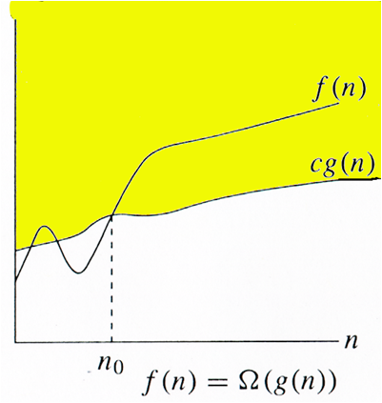
Omega Notation (Ω)
Express the lower bound of an algorithm's running time.
measure of best case time complexity
for a function f(n)
If f(n)= Ω(g(n) : there exists c > 0 and n₀ such that c.g(n) ≤ f(n) for all n > n₀. }
Ex: if f(n)=3n²+2n+1 then we can take g(n)=n² for c=1, s.t
f(n)>=3.g(n) for all n>=1(n₀), c=3
Therefore f(n)= Ω(n)

Slide 16
Little ω (omega) asymptotic notation
Small-omega, commonly written as ω,
denotes the lower bound (that is not asymptotically tight) on the growth rate of runtime of an algorithm.
f(n)=ω(g(n)), if for all real constants c (c > 0) and n₀ (n₀ > 0), f(n) is > c g(n) for every input size n (n > n₀).
in f(n) = Ω(g(n)), the bound f(n) >= g(n) holds for some constant c > 0,
but in f(n) = ω(g(n)), the bound f(n) > c g(n) holds for all constants c > 0.

Slide 17
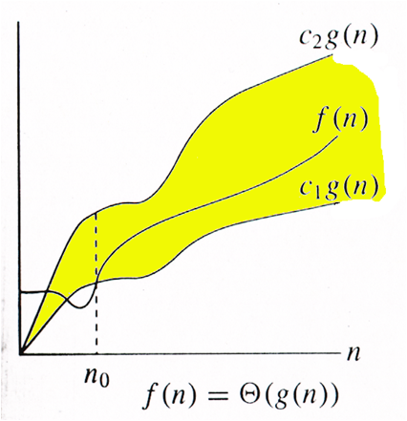
Theta Notation(θ)
Theta, commonly written as Θ, is an Asymptotic Notation to denote the asymptotically tight bound on the growth rate of runtime of an algorithm.
Express both lower bound and the upper bound of an algorithm's running time.
Θ(g(n)) = {f(n): there exist positive constants c1, c2 and n0 such that 0 <= c1*g(n) <= f(n) <= c2*g(n) for all n >= n0}
f(n) is always between c1*g(n) and c2*g(n) for large values of n (n >= n0)

Slide 18
Theta Notation(θ)
Example: f(n)=3n+2
We show that f(n)<=C1.g(n)
let g(n)=n and C1=4
by def. of Big-O
3n+2<=4. n which is true for all n>2(n0)
Now we have to show C2.g(n)<=f(n) for satisfying omega notation
here g(n)=n, let C2=1, then
1. n<=3n+2 is also true for all n>2(n0)
Therefore by definition of theta notation
F(n)= Θ(g(n))= Θ(n) for constants C1=4 and C2=1 for all n>2

Slide 20
Order Notations
Big-O | T(n) = O( f(n) ) Exist positive constants c, n₀ such that T(n) ≤ cf(n) for all n ≥ n₀ | Upper bound
Omega | T(n) = Ω( f(n) ) Exist positive constants c, n₀ such that T(n) ≥ cf(n) for all n ≥ n₀ | Lower bound
Theta | T(n) = θ( f(n) ) T(n) = O(f(n)) AND T(n) = Ω(f(n)) | Tight bound
little-o | T(n) = o( f(n) ) T(n) = O(f(n)) AND T(n) != θ(f(n)) | Strict upper bound

Slide 21
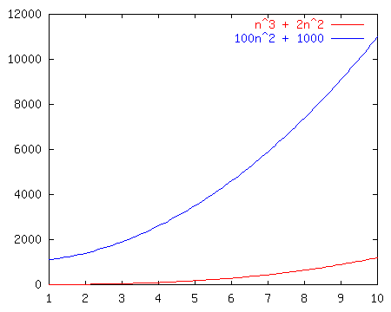
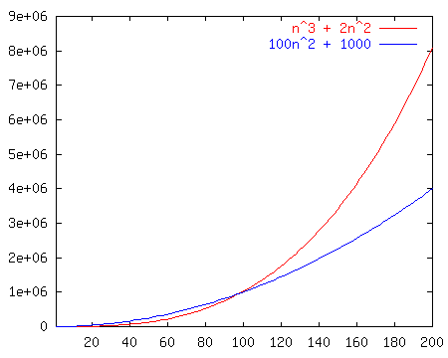
Race 1
vs.
100n² + 1000
n³ + 2n²

Slide 22
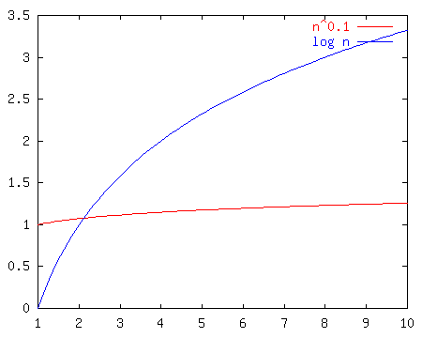
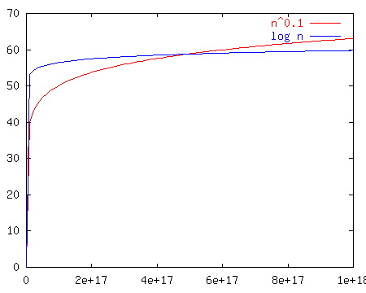
Race 2
n^{0.1}
vs.
log n
In this one, crossover point is very late! So, which algorithm is really better???

Slide 23
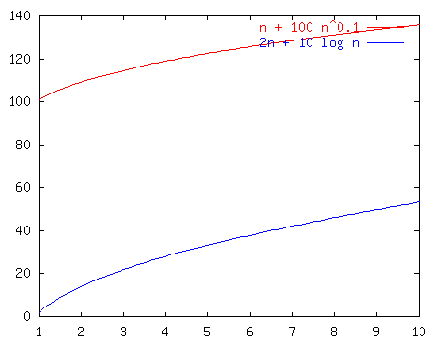
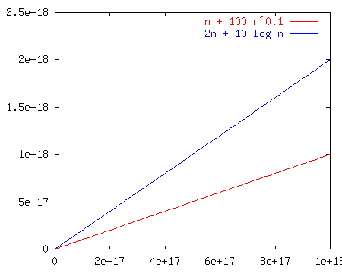
Race C
n + 100n^{0.1}
vs.
2n + 10 log n
Is the “better” algorithm asymptotically better???

Slide 24
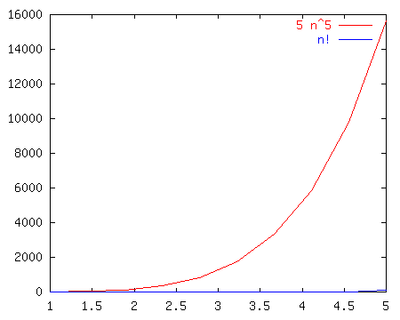
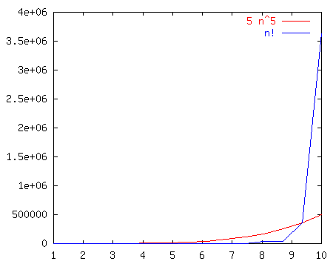
Race 4
5n⁵
vs.
n!

Slide 25
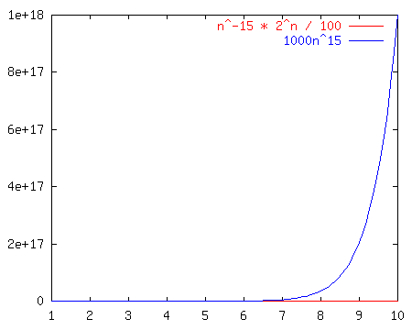
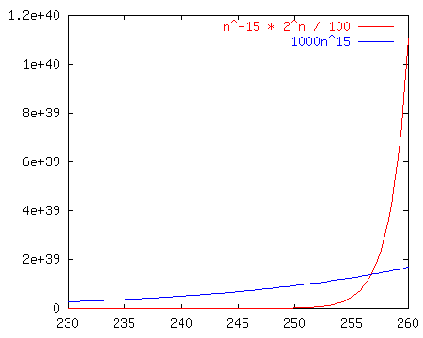
Race 5
n⁻¹⁵2^{n}/100
vs.
1000n¹⁵

Slide 26
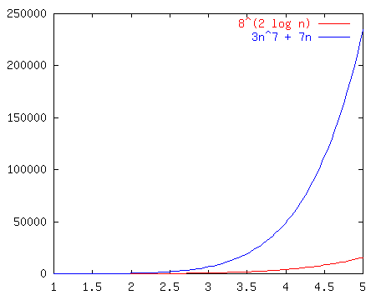
Race VI
8^{2log(n)}
vs.
3n⁷ + 7n

Slide 27
Big-O Winners (i.e. losers)
Function A
n³ + 2n²
n^{0.1}
n + 100n^{0.1}
5n⁵
n⁻¹⁵2^{n}/100
Function #2
100n² + 1000
log n
2n + 10 log n
n!
1000n¹⁵
Winner
O(n²)
O(log n)
O(n) TIE
O(n⁵)
O(n¹⁵)
vs.

Slide 28
Big-O Common Names
constant: O(1)
logarithmic: O(log n)
linear: O(n)
log-linear: O(n log n)
superlinear: O(n^{1+c}) (c is a constant > 0)
quadratic: O(n²)
polynomial: O(n^{k}) (k is a constant)
exponential: O(c^{n}) (c is a constant > 1)

Slide 29
An algorithm is said to run in polylogarithmic time if T(n) = O((log n)^{k}), for some constant k. For example, matrix chain ordering can be solved in polylogarithmic time on a Parallel Random Access Machine
Sub-linear time if T(n) = o(n). includes algorithms with the time complexities defined above, as well as others such as the O(n^{½}). Sub-linear time algorithms are typically randomized, and provide only approximate solutions.
Linear time, time complexity is O(n). For large enough input sizes the running time increases linearly with the size of the input.
Quasi linear time if T(n) = O(n log^{k} n) for any constant k; linearithmic time is the case k = 1. Using soft-O notation these algorithms are Õ(n). Quasilinear time algorithms are also o(n^{1+ε}) for every ε > 0, and thus run faster than any polynomial in n with exponent strictly greater than 1.
Linearithmic time is a special case of quasilinear time where the exponent, k = 1 on the logarithmic term.

Slide 30
Subquadratic time if T(n) = o(n²).
For example, simple, comparison-based sorting algorithms are quadratic (e.g. insertion sort), but more advanced algorithms can be found that are subquadratic (e.g. Shell sort). No general-purpose sorts run in linear time, but the change from quadratic to sub-quadratic is of great practical importance.
Polynomial time if its running time is upper bounded by a polynomial expression in the size of the input for the algorithm, i.e., T(n) = O(n^{k}) for some constant k. Problems for which a deterministic polynomial time algorithm exists belong to the complexity class P
superpolynomial time if T(n) is not bounded above by any polynomial. It is ω(n^{c}) time for all constants c, where n is the input parameter, typically the number of bits in the input.
For example, an algorithm that runs for 2^{n} steps on an input of size n requires superpolynomial time.
Quasi-polynomial time : run slower than polynomial time, yet not so slow as to be exponential time. The worst case running time of a quasi-polynomial time algorithm is for some fixed c. The best-known classical algorithm for integer factorization

Slide 31
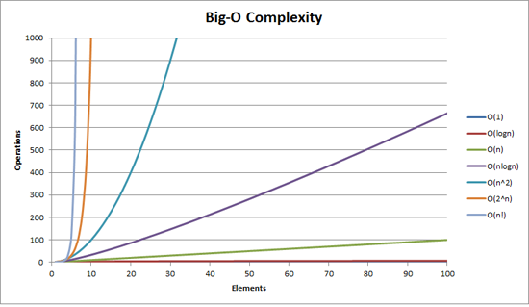

Slide 32
Insertion Sort Example
InsertionSort(A, n) { for i = 2 to n { key = A[i] j = i - 1; while (j > 0) and (A[j] > key) { A[j+1] = A[j] j = j - 1 } A[j+1] = key }
}
How many times will this loop execute?

Slide 33
Insertion Sort
Statement Effort
InsertionSort(A, n) {
for i = 2 to n { c₁n
key = A[i] c₂(n-1)
j = i - 1; c₃(n-1)
while (j > 0) and (A[j] > key) { c₄T
A[j+1] = A[j] c₅(T-(n-1))
j = j - 1 c₆(T-(n-1))
} 0
A[j+1] = key c₇(n-1)
} 0
}
T = t₂ + t₃ + … + t_{n} where t_{i} is number of while expression evaluations for the i^{th} for loop iteration

Slide 34
Analyzing Insertion Sort
What can T be?
Best case -- inner loop body never executed
t_{i} = 1 ➔ T(n) is a linear function
Worst case -- inner loop body executed for all previous elements
t_{i} = i ➔ T(n) is a quadratic function
Average case
???

Slide 39
Tips for solving Questions On Asymptotic
#Tip1
One should remenber the general order of following functions.
O(1) < O(logn) < O( n) < O( nlogn) < O(n*n) < O(n*n*n) < O(n^{k})< O(2^{n})
#Tip2
if f(x) = ϴ (g(x)) , we can say that f(x) is O(g(x)) and f(x) is Ω(g(x))
and also g(x) is O(f(x)) and Ω(f(x))
#Tip3
The running time of for/while loop is number of iterations * running time of statement inside loop.
int sum=0;
for (int i=0;i<n;i++)
{
Sum=sum +i,
}
The running time is O(n)
#Tip4: For nested loop
The running time of statement inside group of nested loop is product of size of loops.
for (i=0; i<n; i++)
for (j=0; j<k; j++)
a++;
The running time is O(n×k)

Slide 40
#Tip5
sum of statements:
Add running time of all the statements
for (i=0;i<n; i++)
k++ → O(n)
for (j=0; j<n; j++)
for (t=0, t<n; t++)
The running time is 0(n) + 0(n²)
#Tip6
Recursive function
Derive recurrence relation and then solve it ,getting the running time is always better way than other structure.
→ Suppose T(n) is running time of function ABC and the variable reduces to half in next call.
T(n) = T(n/2) + complexity rest of code
#Tip7
An algorithm is O(log n) if it takes constant time to cut problem of half.
Like binary score, heap.
# T(sqrt(n )) → O(loglog n)
where T is recurrence relation
#Tip8
int doSomething (int n) { if (n≤ 2)
return 1;
else
return doSomething ( floor(sqrt (n)) + n)
}

Slide 41
QUIZ

Slide 42
QUIZ
Q 1. Consider the following three claims
(n + k)^{m} = Θ(n^{m}), where k and m are constants
2^{n + 1} = O(2^{n})
2^{2n + 1} = O(2^{n})
Which of these claims are correct ?
(A) 1 and 2 (B) 1 and 3 (C) 2 and 3 (D) 1, 2, and 3
Answer: (A) Explanation: (n + k)^{m} and Θ(n^{m}) are asymptotically same as theta notation can always be written by taking the leading order term in a polynomial expression.
2^{n + 1} and O(2^{n}) are also asymptotically same as 2^{n + 1} can be written as 2 * 2^{n} and constant multiplication/addition doesn’t matter in theta notation.
2^{2n + 1} and O(2^{n}) are not same as constant is in power.

Slide 43
QUIZ
Q) Is f(n) O(g(n))? Is 3 log n + 100 O(log n)?
Let’s look to the definition of Big-O.
3log n + 100 <= c * log n
Is there some pair of constants c, n₀ that satisfies this for all n > n₀?
3log n + 100 <= 150 * log n, n > 2 (undefined at n = 1)
the definition of Big-O has been met ,therefore f(n) is O(g(n)).
Q) f(n) = 3*n^2 and g(n) = n , Is f(n) O(g(n))? Is 3 * n^2 O(n)?
Let’s look at the definition of Big-O.
3 * n^2 <= c * n
Is there some pair of constants c, n₀ that satisfies this for all n > ₀? No, there isn’t. f(n) is NOT O(g(n)).

Slide 44
QUIZ
Q2 . Suppose you have algorithms with the five running times listed below. How much slower do each of these algorithms get when you (a) double the input size, or (b) increase the input size by one?
1. n² ;
2. n³ ;
3. 100n² ;
4. nlog(n);
5. 2^{n}
Q 3. If f(n) = n+2, Can we write f(n)=O(n²) ?
Q 4. f(n) = 3n² + 4n + 1. Show f(n) is O(n²)
Q 5. f(n) = 10n + 5 and g(n) = n show that f(n) is O(g(n))

Slide 45
QUIZ
Q6. Take the following list of functions and arrange them in ascending order of growth rate.
• f1(n) = n^{2.5}
• f2(n) =√2n
• f3(n) = n + 10
• f4(n) = 10^{n}
• f5(n) = 100^{n}
• f6(n) = n²log(n)
Q7. Which of the following is not O(n^2)? (A) (15^10) * n + 12099 (B) n^1.98 (C) n^3 / (sqrt(n)) (D) (2^20) * n
Answer:(C)
Explanation: The order of growth of option c is n^2.5 which is higher than n^2.

Slide 46
QUIZ
State True or False.
Q.8. 3n^2 + 10 n log n = O(n log n)
Q.9. 3 n^2 + 10 n log n = Omega(n^2)
Q.10. 3 n^2 + 10 n log n = Theta(n^2)
Justify your answers
Q. 11. 1,000,000 n² ∈ O(n²) why/why not?
Q.12. (n - 1)n / 2 ∈ O(n²) why /why not?
Q. 13. n / 2 ∈ O(n²) why /why not?
Q. 14. lg (n²) ∈ O( lg n ) why /why not?
Q. 15. n² ∈ O(n) why /why not?

Slide 47
QUIZ
The auxiliary space of insertion sort is O(1), what does O(1) mean ? (A) The memory (space) required to process the data is not constant. (B) It means the amount of extra memory Insertion Sort consumes doesn’t depend on the input. The algorithm should use the same amount of memory for all inputs. (C) It takes only 1 kb of memory . (D) It is the speed at which the elements are traversed.
Explanation: The term O(1) states that the space required by the insertion sort is constant i.e., space required doesn’t depend on input.

Slide 48
QUIZ

Slide 49
QUIZ

Slide 50
QUIZ
Consider the array A[]= {6,4,8,1,3} apply the insertion sort to sort the array . Consider the cost associated with each sort is 25 rupees , what is the total cost of the insertion sort when element 1 reaches the first position of the array ? (A) 50 (B) 25 (C) 75 (D) 100 Answer: (A) Explanation: When the element 1 reaches the first position of the array two comparisons are only required hence 25 * 2= 50 rupees.
*step 1: 4 6 8 1 3 .
*step 2: 1 4 6 8 3.

Slide 51
Solved Exercise
Q: From lowest to highest, what is the correct order of the complexities O (n2), O (3n), O (2n), O (n2 lg n), O (1), O (n lg n), O (n3), O (n!), O (lg n), O (n)?
A: From lowest to highest, the correct order of these complexities is O (1), O (lg n), O (n), O (n lg n), O (n²), O (n² lg n), O (n³), O (2n), O (3n), O (n!).
Q: What are the complexities of T1(n) = 3n lg n + lg n; T2(n) = 2n + n3 + 25; and T3(n, k) = k + n? From lowest to highest, what is the correct order of the resulting complexities?
A: Using the rules of O -notation, the complexities of T₁, T₂, and T₃ respectively are O (n lg n), O (2n), and O (n). From lowest to highest, the correct order of these complexities is O (n), O (n lg n), and O (2n).
Q: Suppose we have written a procedure to add m square matrices of size n x n. If adding two square matrices requires O (n² ) running time, what is the complexity of this procedure in terms of m and n?
A: To add m matrices of size n x n, we must perform m - 1 additions, each requiring time O (n²). Therefore, the overall running time of this procedure is:
O(m-1)O(n²) = O(m)O(n²) = O(mn²)
Q: Suppose we have two algorithms to solve the same problem. One runs in time T1(n) = 400n, whereas the other runs in time T2(n) = n2. What are the complexities of these two algorithms? For what values of n might we consider using the algorithm with the higher complexity?
A: The complexity of T₁ is O (n), and the complexity of T₂ is O (n²). However, the algorithm described by T₁ involves such a large constant coefficient for n that when n < 400, the algorithm described by T₂ would be preferable. This is a good example of why we sometimes consider other factors besides the complexity of an algorithm alone.

Slide 54
Thank You

